Slide 1

2. Kubernetes and OpenShift Command-line Interfaces and APIs

Slide 2
Managing OpenShift Clusters: Web Console vs. Command-Line Tools
OpenShift clusters can be managed through the web console or by using command-line interfaces such as `kubectl` or `oc`. `kubectl` commands are native to Kubernetes and serve as a lightweight interface over the Kubernetes API. In contrast, the `oc` commands are an extended set of tools that include all `kubectl` commands, plus additional commands specific to OpenShift features.

Slide 3
Understanding User Authentication in OpenShift
In OpenShift, users must log in (authenticate) before they can interact with the cluster. This login process ensures the system knows who is making the requests. Once logged in, the system checks what the user is allowed to do based on their assigned permissions. There are three main types of users in OpenShift:
Regular Users: These are everyday users, like developers and administrators, who interact with the platform. Permissions are granted to them based on roles assigned to them or their groups.
System Users: These are special users that handle the platform’s background tasks. For example, a system administrator has full access to everything, while other system users handle automated tasks.
Service Accounts: These are accounts used by services or applications within a project. When a new project is created, OpenShift automatically creates service accounts for it. Project administrators can also create additional service accounts to manage access within that project.

Slide 4
Summary of Kubernetes and OpenShift Main Resource Types
Pods (pod): A collection of containers sharing resources like IP addresses and storage, representing the smallest unit of work in Kubernetes.
Services (svc): Define a single IP/port combination for accessing a pool of pods, connecting clients to pods in a round-robin fashion.
ReplicaSet (rs): Ensures a specified number of pod replicas are running at all times.
Persistent Volumes (pv): Define storage areas for pods to use.
Persistent Volume Claims (pvc): Requests for storage from a pod, linking PVs to pods so containers can use the storage.
ConfigMaps (cm) & Secrets: Store key-value pairs used by other resources. Secrets differ by encoding values for security.
Deployment (deploy): Defines the configuration for a set of containers, managing strategies like scaling and updating containers.
BuildConfig (bc): (OpenShift-specific) Defines a process, often used with Source-to-Image (S2I) for building container images from application code.

Slide 5
Summary of Kubernetes and OpenShift Main Resource Types
DeploymentConfig (dc): (OpenShift-specific) Deprecated in favor of Deployment, but still available for managing pod deployment strategies.
Routes: (OpenShift-specific) Provide DNS hostnames that the OpenShift router recognizes for routing traffic to applications.
Resource Structure: Each Kubernetes resource has a spec (intended state) and status (current state). Kubernetes automatically works to align the status with the spec.
Condition Resource Fields: Represent conditions of a resource like readiness, with fields for type, status, reason, message, and last transition time.
API Resource Fields: Common fields like apiVersion, kind, metadata.name, metadata.namespace, and metadata.labels that identify and describe the resource within Kubernetes.

Slide 6
Assessing the Health of an OpenShift Cluster: Key Points
• Operators in OpenShift: Operators automate tasks to maintain a healthy OpenShift cluster, managing services and integrating with Kubernetes APIs and tools like kubectl and oc. They monitor applications, perform health checks, manage updates, and ensure the desired state of applications.
• Control Plane: Most cluster functions are managed on the control plane through Operators, including networking and credential services.
• Management Systems: There are two systems for managing Operators:
Cluster Version Operator (CVO): Manages cluster-level functions and is responsible for default cluster operators.
Querying Operators: Cluster operators have the Kubernetes kind clusteroperators, and you can use the oc get clusteroperators command (with cluster-admin permissions) to list all operators and check their status.

Slide 7
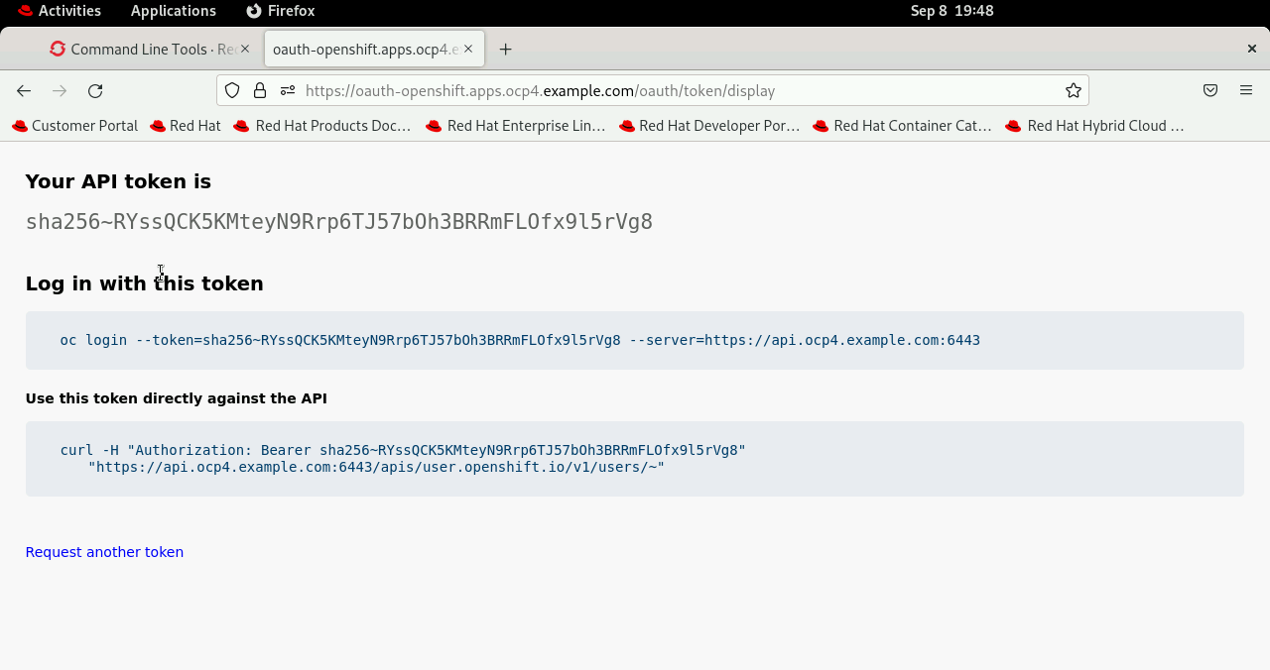
Guided exercises: Command Line Interfaces
Get the OAuth token by using the OpenShift web console, navigate to Help → Command line tools. The Help menu is represented by a ? icon

Slide 8
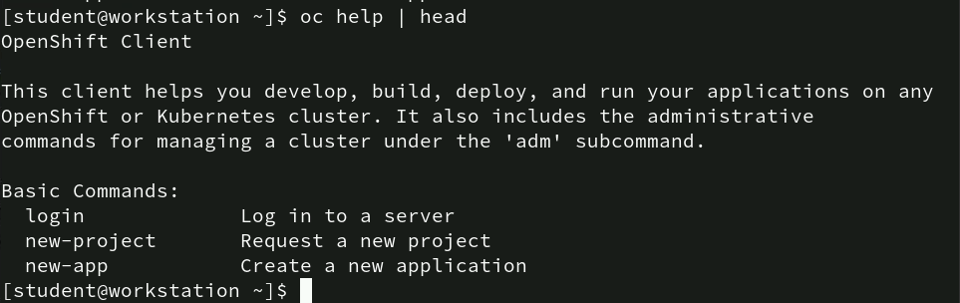
Command: oc help
This command provides help and documentation for the oc (OpenShift Client) command-line interface. It displays a list of commands and their descriptions. The pipe (|) is used to send the output of the oc help command into the head command, which limits the output to the first few lines (typically the first 10).

Slide 9
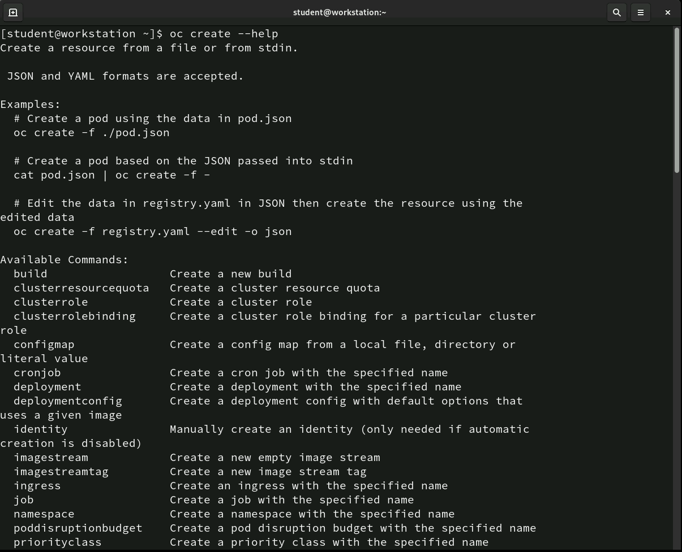
Command: oc create
The oc create command is used to create resources in OpenShift, typically from files in JSON or YAML formats.
Commonly used for setting up resources like builds, jobs, and namespaces, it helps manage your OpenShift applications easily and efficiently.

Slide 10
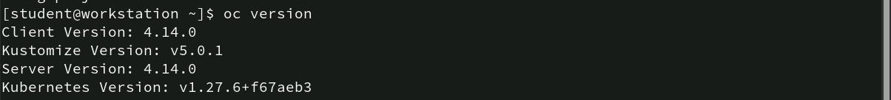
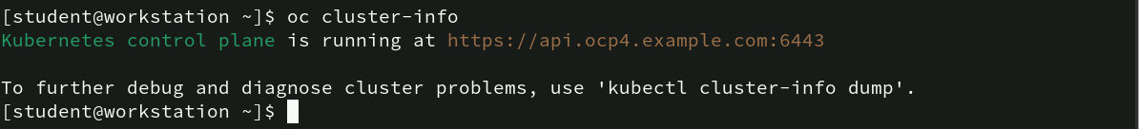
Command: oc version, oc cluster-info
The `oc version` command provides details about the versions of the OpenShift client, server, Kustomize, and Kubernetes in the environment.
It's a quick way to check the compatibility between the client and the connected OpenShift cluster.
The `oc cluster-info` command shows the Kubernetes control plane's URL and suggests using `kubectl cluster-info dump` for more detailed debugging information.

Slide 11
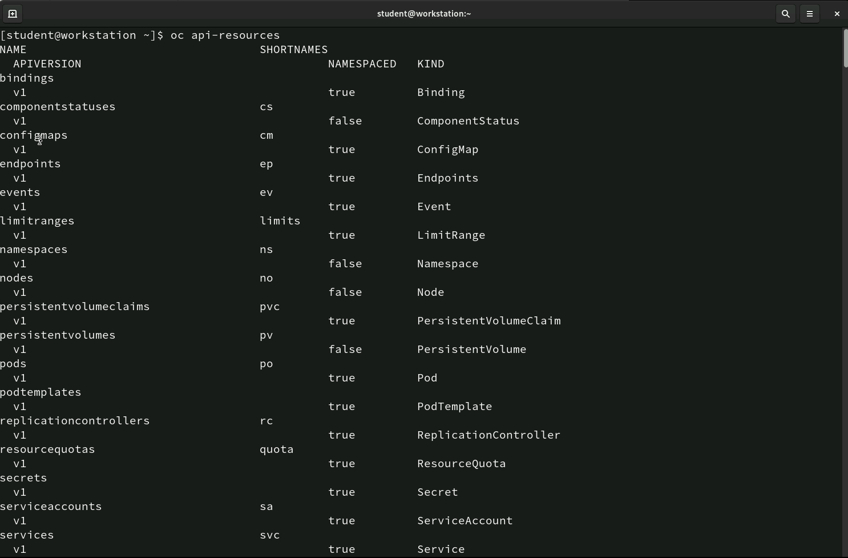
Command: oc api-resources
The `oc api-resources` command lists all the available API resources in the OpenShift cluster.
It shows details such as the resource name, short names, API version, whether the resource is namespaced, and its kind.
This command helps identify the resources you can manage within OpenShift, such as pods, services, config maps, namespaces, and more.

Slide 12
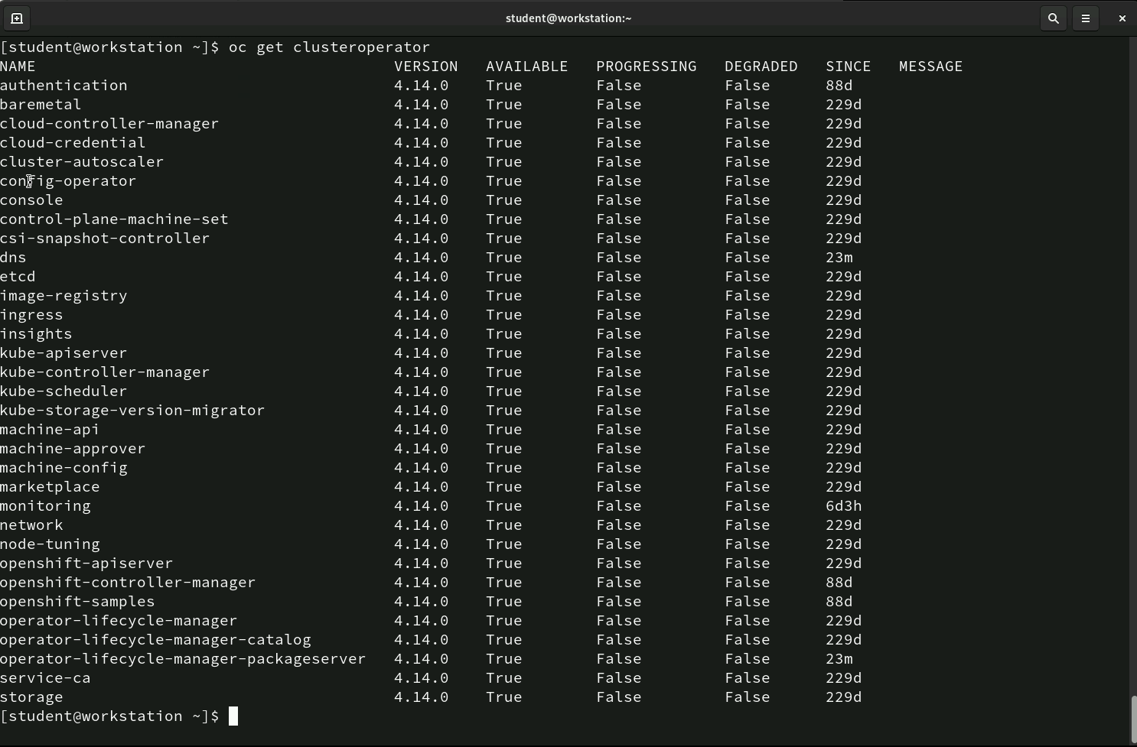
Command: oc get clusteroperator
The `oc get clusteroperator` command displays the status of all cluster operators in an OpenShift cluster.
It gives details such as the version, availability, whether it's progressing or degraded, and how long it has been in the current state.
This command helps monitor the health and functionality of operators managing key components of the cluster.

Slide 13
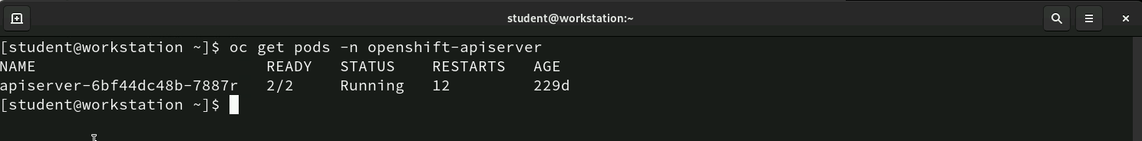
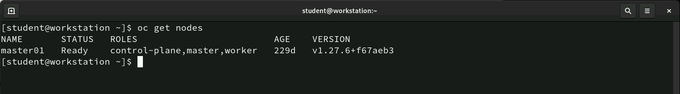
Command: oc getpods, oc get nodes
The `oc get pods -n openshift-apiserver` command shows the status, readiness, restarts, and age of pods in the `openshift-apiserver` namespace, helping to monitor their health.
The `oc get nodes` command shows the nodes in the cluster, their status, roles, age, and Kubernetes version. It helps monitor the nodes' health and roles in the cluster.

Slide 14
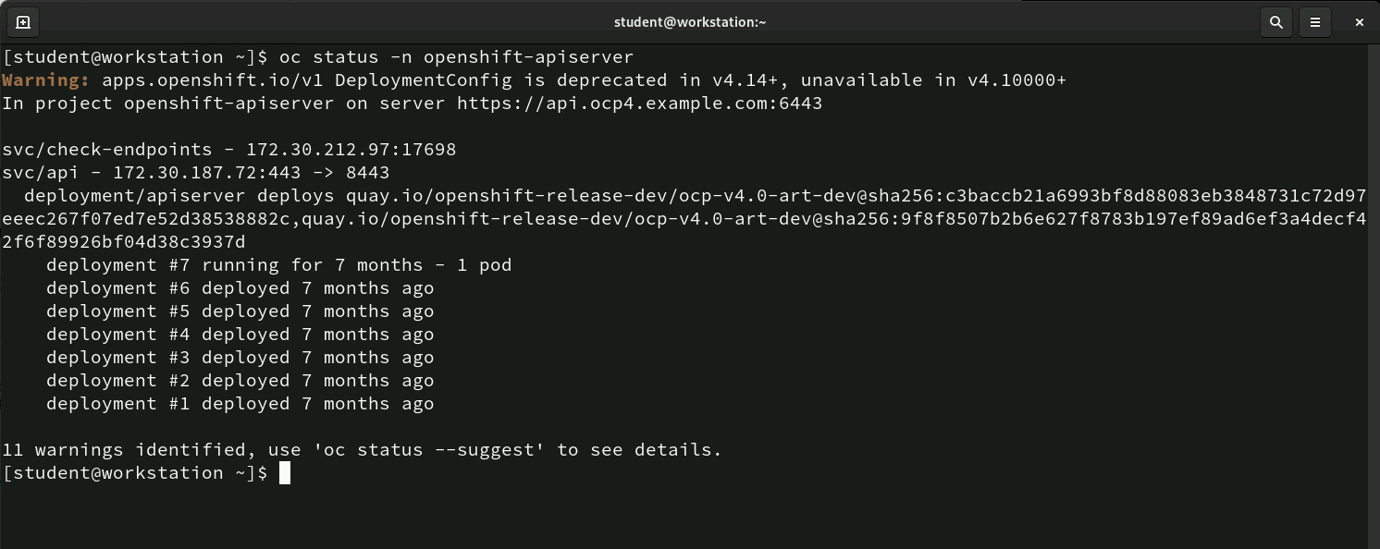
Command: oc status
The command `oc status -n openshift-apiserver` gives an overview of the status of resources in the `openshift-apiserver` namespace.
It shows the current deployments, services, and any warnings (e.g., deprecated features). In this example, the deployment details are listed, showing that the latest deployment has been running for 7 months and gives a summary of previous deployments. It also suggests using `oc status --suggest` for more details on the warnings identified.
This command helps to quickly understand the state of the application and any issues that may need attention.

Slide 15
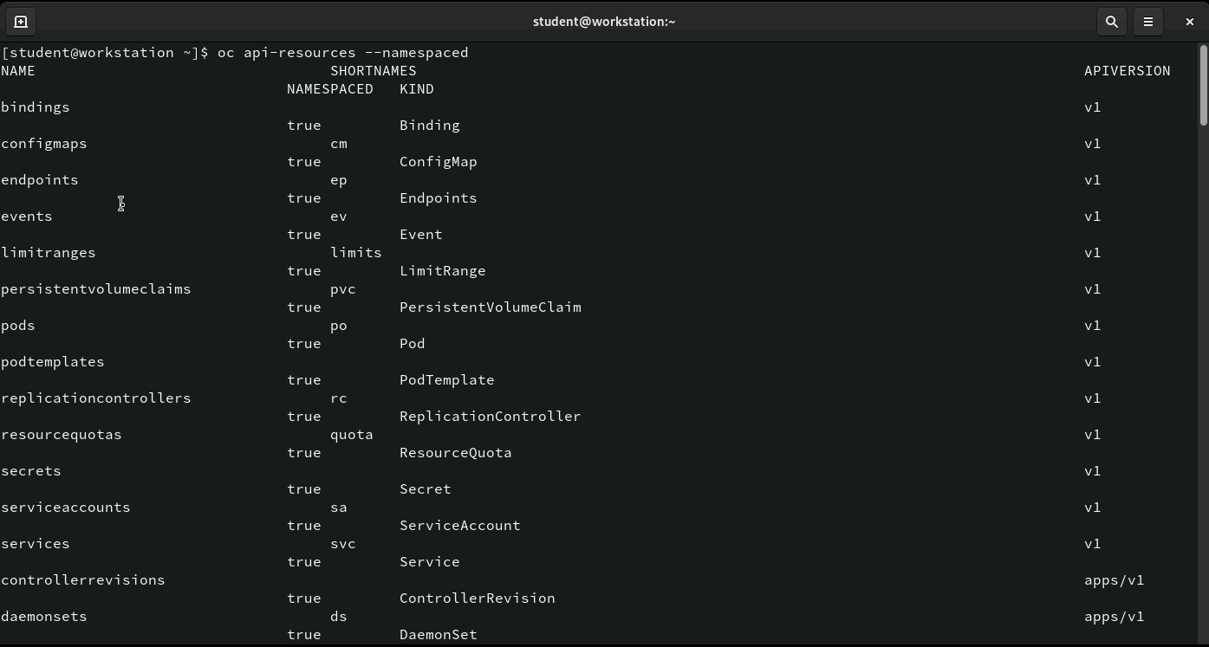
Command: oc api-resources
The command `oc api-resources --namespaced` lists all the namespaced resources available in the OpenShift cluster.
It shows the resource names, short names, kinds, and API versions, helping to identify resources that are specific to individual namespaces (like pods, services, and config maps). This is useful for managing resources within specific namespaces.

Slide 16
Command: oc api-resources
Counts the number of namespaced resources (like Pods, Services, etc.) in the OpenShift cluster. The result, 113, shows there are 113 such resources.
Lists all the non-namespaced resources (like nodes, cluster-wide configurations, etc.) in the OpenShift cluster and counts them. The result, 118, shows there are 118 non-namespaced resources available.

Slide 17
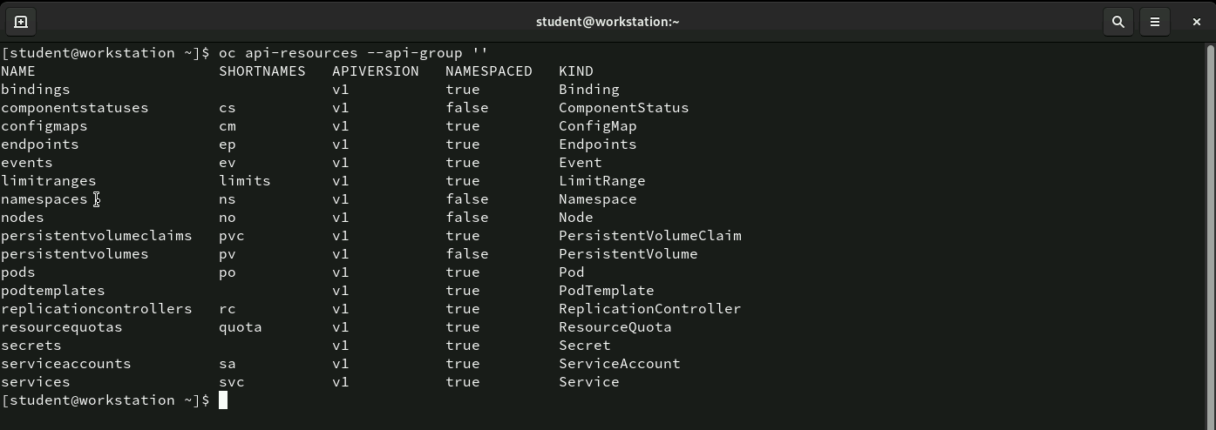
Command: oc api-resources –api-group ‘’
Lists all core API resources in OpenShift (those without a specific API group).
The output shows resource names, shortnames, API versions, whether they are namespaced, and their type (kind).
It helps identify built-in Kubernetes resources like Pods, Services, and ConfigMaps.

Slide 18
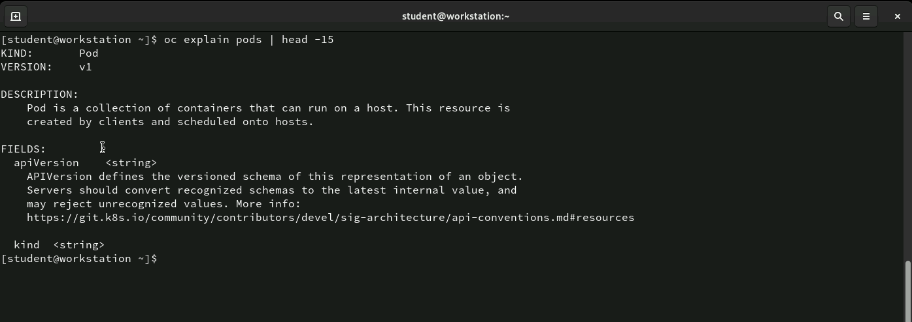
Command: oc explain pods
The command oc explain pods | head -15 provides a brief explanation of what a Pod is in OpenShift.
It describes the Pod as a collection of containers that can run on a host, with details on its kind (Pod) and API version (v1).
This command helps users quickly understand the structure and main attributes of a Pod.

Slide 19
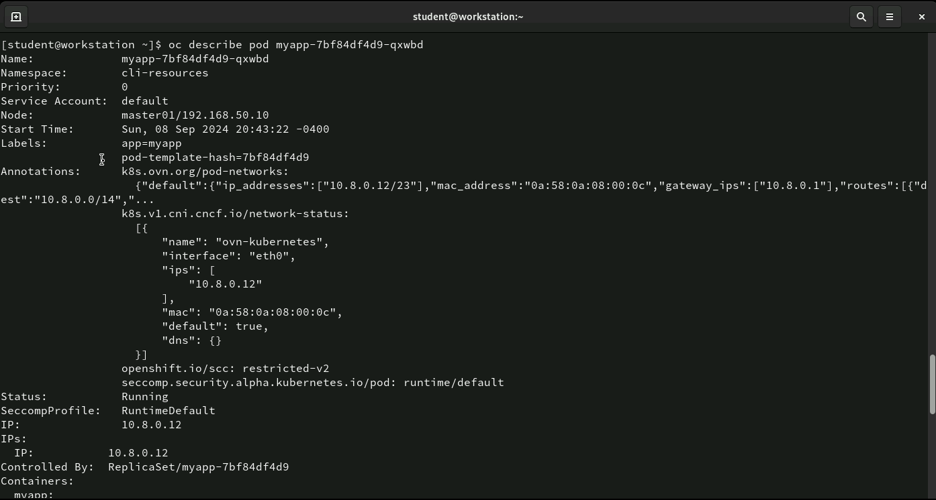
Command: oc describe pod
The command oc describe pod myapp-7bf84df4d9-qxwbd provides detailed information about the specified Pod in OpenShift.
It shows key details such as the Pod’s name, namespace, node it’s running on, start time, service account, labels, and annotations. Additionally, it includes the Pod’s status (Running), IP address, and information about the controller managing the Pod (a ReplicaSet in this case).
This command is useful for troubleshooting or understanding the Pod’s current state and configuration.

Slide 20
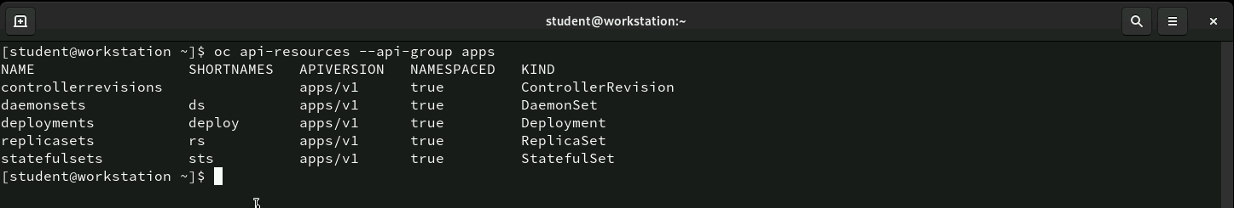
Command: oc api-resources --api-group apps
The command oc api-resources --api-group apps lists all resources related to application management under the apps API group in OpenShift. This includes resources like Deployments, ReplicaSets, StatefulSets, and DaemonSets, with details about their shortnames, API version (apps/v1), and whether they are namespaced (all true in this case). These resources are crucial for managing applications within OpenShift.

Slide 21
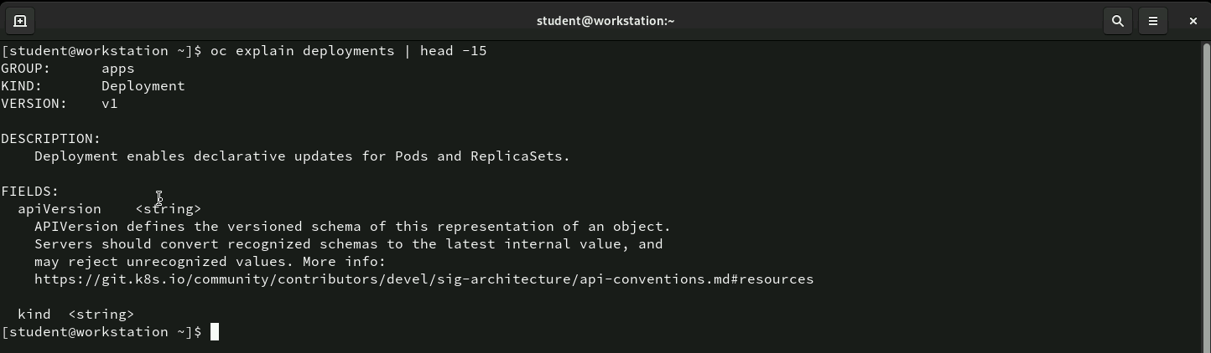
Command: oc explain deployments
The command oc explain deployments | head -15 provides a brief explanation of the Deployment resource in OpenShift. It shows that Deployments, part of the apps API group, enable declarative updates for Pods and ReplicaSets, allowing efficient management of application updates and scaling. The output also lists key fields like apiVersion and kind.

Slide 22
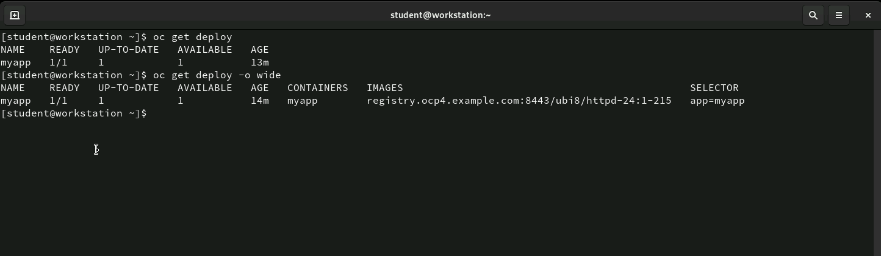
Command: oc get deploy
The oc get deploy command shows a quick overview of deployment status, including readiness, availability, and age. The oc get deploy -o wide command provides more details, such as container images and selectors, for a deeper look into the deployment’s configuration.

Slide 23
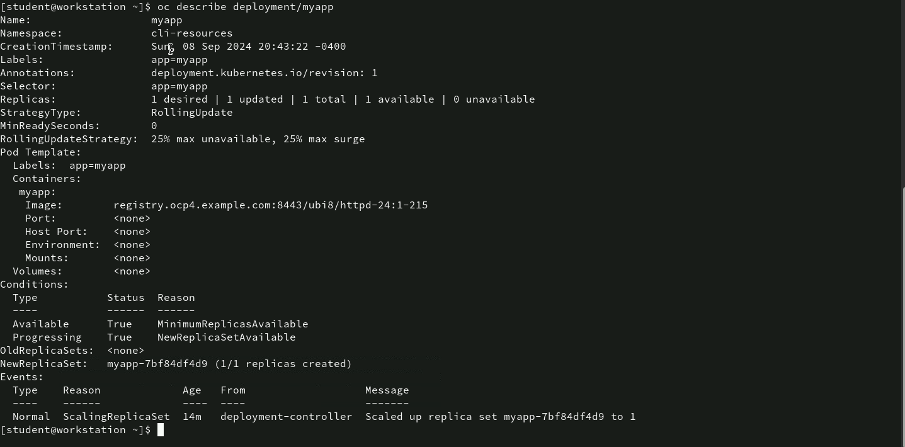
Command: oc describe deployment/myapp
The command oc describe deployment/myapp provides detailed information about the myapp deployment, including the namespace, creation time, labels, replica status, deployment strategy (RollingUpdate), and the container image being used.
It also shows the current conditions of the deployment and logs relevant events, such as scaling actions. This helps in monitoring and troubleshooting the deployment.

Slide 24
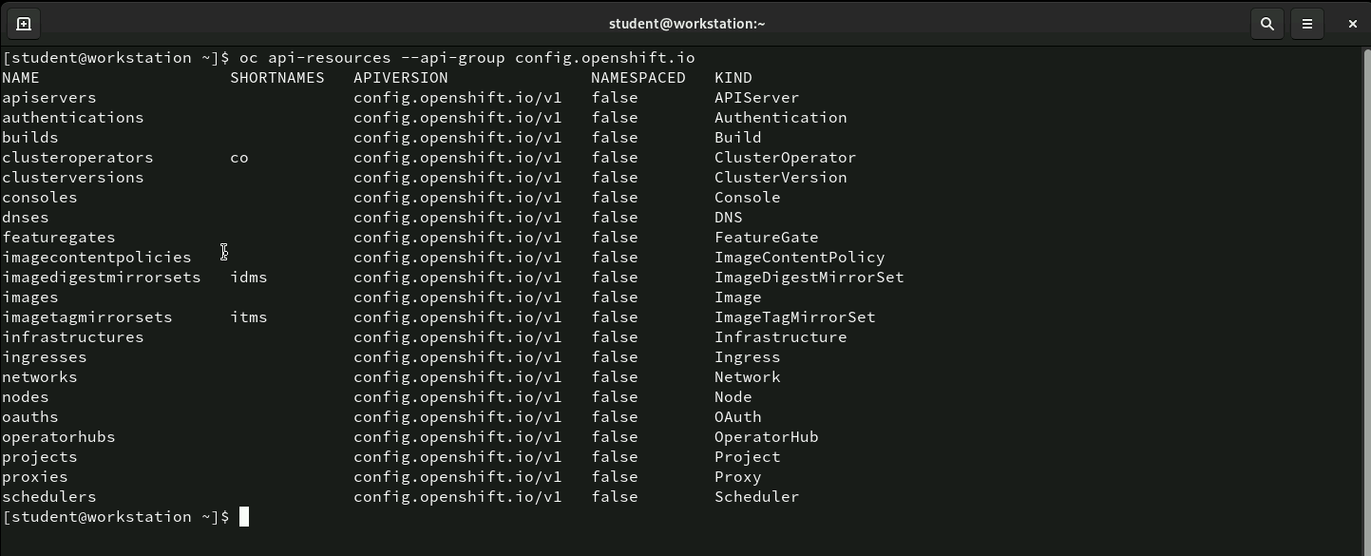
Command: oc api-resources –api-group …
The command oc api-resources --api-group config.openshift.io lists all configuration-related resources in OpenShift that belong to the config.openshift.io API group.
These resources are cluster-wide and not namespaced, and include important types like API servers, ClusterOperators, Nodes, and Projects. This command helps administrators view and manage key configuration resources across the OpenShift cluster.

Slide 25
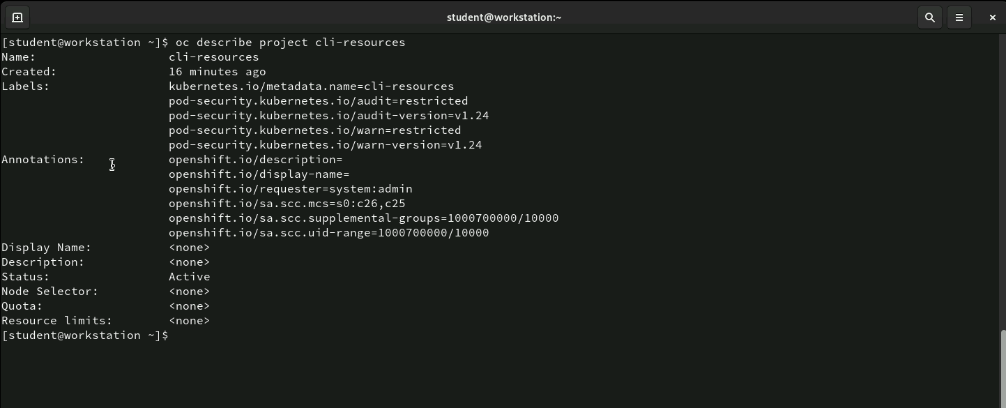
Command: oc describe project cli-resources
The command oc describe project cli-resources provides detailed information about the cli-resources project in OpenShift.
It shows metadata like when the project was created, labels, annotations, security policies, and requester information. The project is currently in an active state, with no specific node selectors, quotas, or resource limits defined.
This command is useful for viewing the configuration and status of the project for management or troubleshooting purposes.

Slide 26
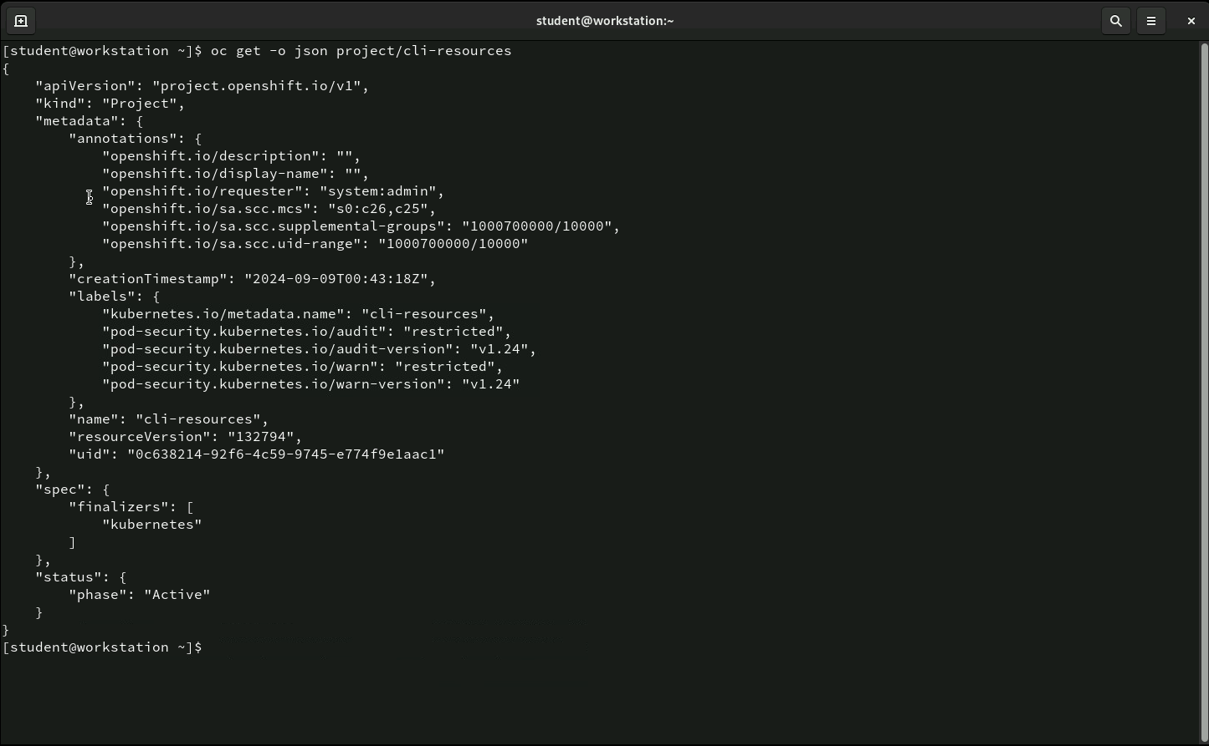
Command: oc get-o json project/cli
The command oc get -o json project/cli-resources retrieves the cli-resources project details in JSON format. It includes key information such as the API version (project.openshift.io/v1), the resource type (Project), and metadata like annotations and labels. Important details include the project requester (system:admin), security context constraints, creation timestamp, and pod security settings.
Additionally, it shows the project name (cli-resources) and confirms its status as Active. This JSON output is useful for exporting project configurations or integrating with automation tools.

Slide 27
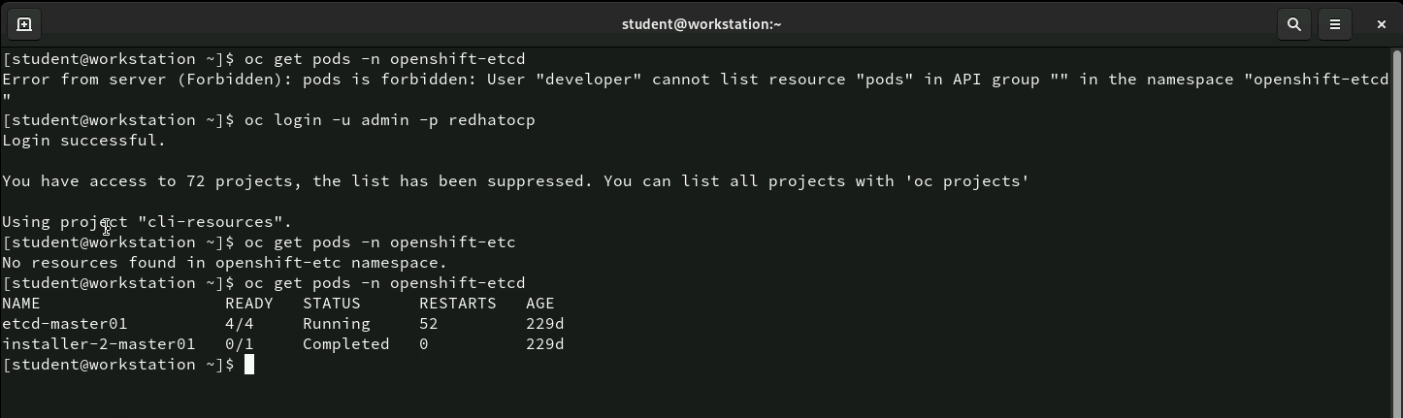
Command: oc get pods, oc get login
The user first attempts to list pods in the openshift-etcd namespace but encounters a permission error as the developer user.
After logging in as the admin, which has higher privileges, they successfully access the openshift-etcd namespace. Initially, no pods are found, but upon a second attempt, the user retrieves details of two pods, etcd-master01 (running) and installer-2-master01 (completed), along with their readiness, status, restarts, and age.

Slide 28
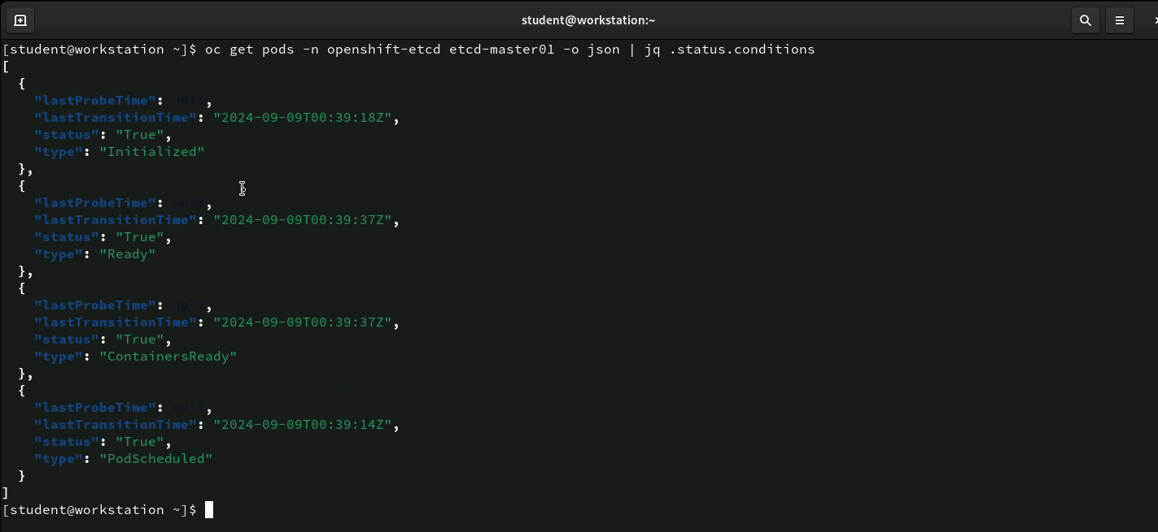
Command: oc get –n openshift-etcd etcd-master01—o json | jq . status.conditions
This command retrieves detailed information about the etcd-master01 pod in the openshift-etcd namespace, formatted as JSON.
The jq tool is used to filter the output to show only the status conditions of the pod, such as whether it’s Initialized, Ready, ContainersReady, and PodScheduled, with their corresponding status and timestamps. This allows for a quick inspection of the pod’s health and readiness.

Slide 29
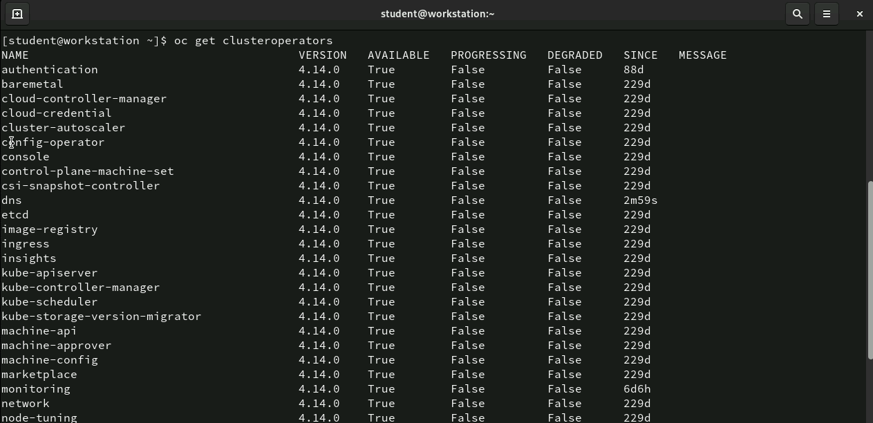
Command: oc get clusteroperators
This command lists all the cluster operators in the OpenShift environment, providing details about each operator’s current version, availability, and health status.
It shows whether the operators are Available, Progressing, or Degraded, along with how long they’ve been in their current state. For example, most operators here are available, not progressing, and not degraded, indicating that they are functioning properly.

Slide 30
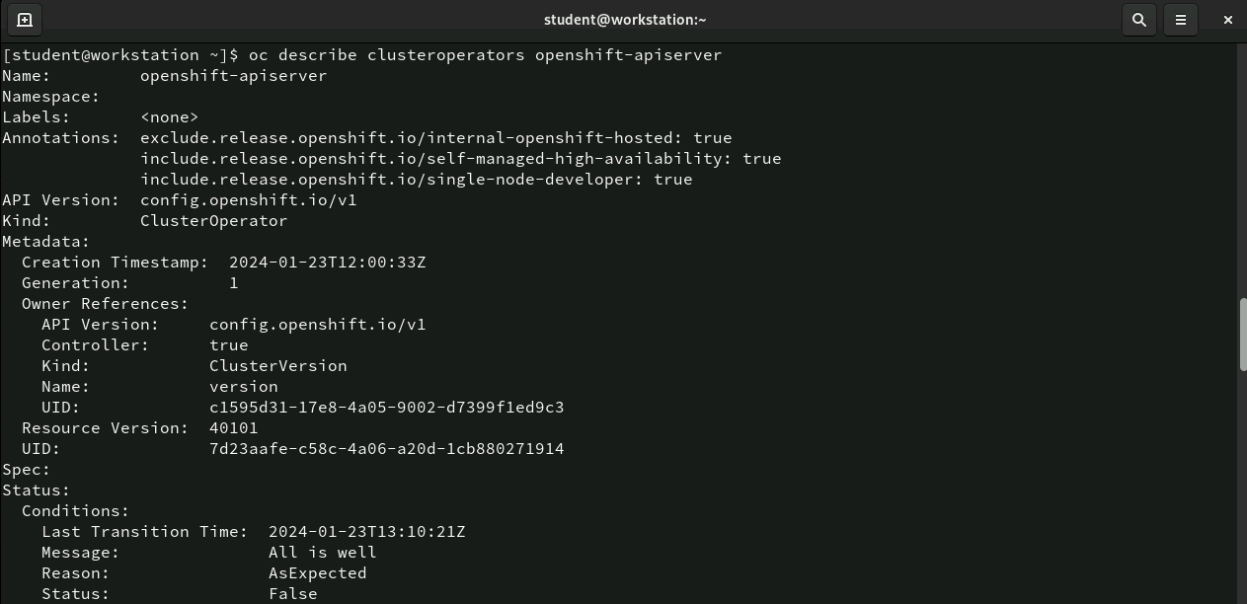
Command: oc describe clusteroperators openshift-apiserver
This command provides a detailed description of the openshift-apiserver cluster operator in OpenShift. It includes metadata such as the API version, creation timestamp, and annotations that define its configuration, like high availability and self-managed settings.
The status section shows conditions like the last transition time, status messages, and whether the operator is functioning as expected.
This command is useful for administrators to review the configuration, state, and health of specific OpenShift cluster operators, helping to ensure the cluster’s components are operating smoothly.

Slide 31
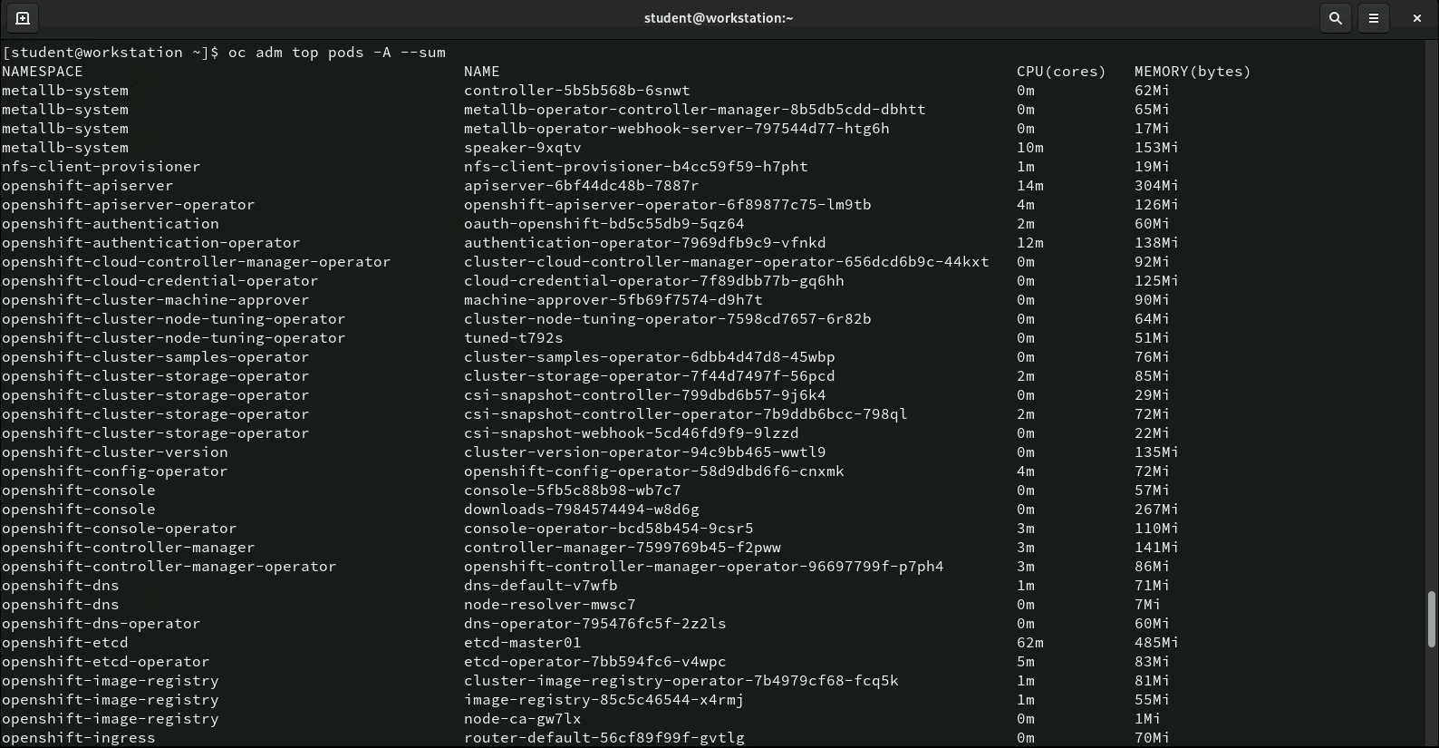
Command: oc adm top pods –A --sum
This command displays the resource usage (CPU and memory) for all pods across all namespaces (-A), summing up the usage for each pod. The output shows the namespace, pod name, CPU usage (in cores), and memory usage (in bytes).
It provides a comprehensive view of how much resources each pod is consuming, which helps in monitoring and managing resource allocation in the cluster.
This command is useful for identifying which pods are consuming the most resources and ensuring that resource usage is within acceptable limits.

Slide 32
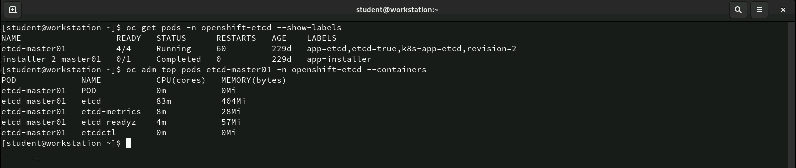
Command: oc get pods, oc adm top pods
The first command lists all the pods in the openshift-etcd namespace, showing their labels and basic status. The second command breaks down the resource usage (CPU and memory) of individual containers inside the etcd-master01 pod, giving deeper insight into container-level resource consumption. This helps in efficiently monitoring the performance of critical services like etcd.

Slide 33
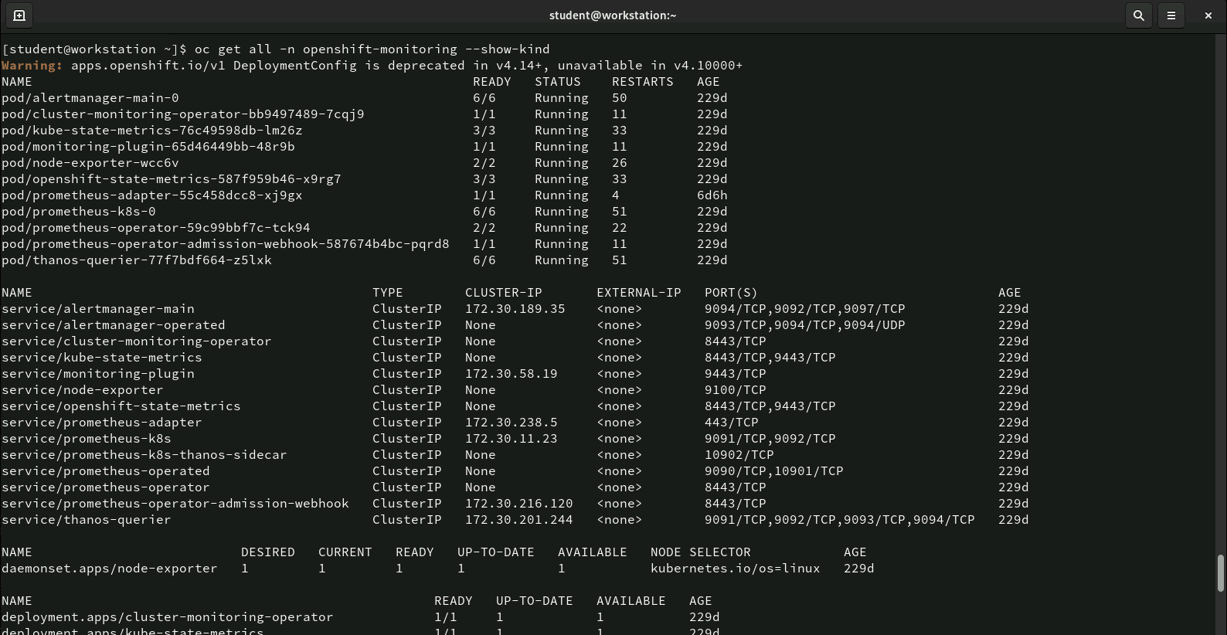
Command: oc get all -n openshift-monitoring --show-kind
This command retrieves all resources in the openshift-monitoring namespace, including pods, services, daemonsets, and deployments. The output provides information such as the readiness of pods, the status of services, their cluster IP addresses, and ports. It also lists the desired and current replica counts for deployments and daemonsets.
This command is useful for administrators to get a comprehensive view of all resources running in the openshift-monitoring namespace, including their status, configuration, and resource allocation. The additional --show-kind option helps to display the type (kind) of each resource for better clarity.

Slide 34
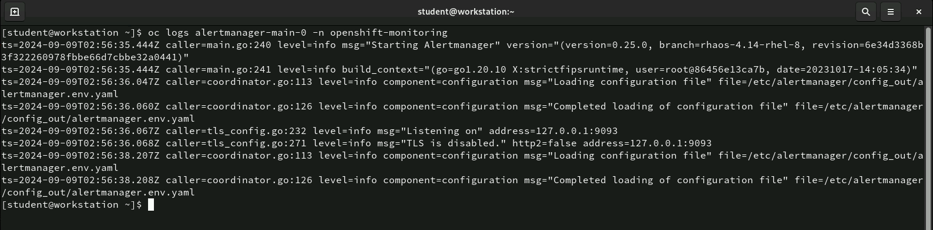
Command: oc logs alertmanager-main-0 -n openshift-monitoring
This command retrieves the logs of the alertmanager-main-0 pod running in the openshift-monitoring namespace. The logs show messages about the initialization of Alertmanager, including the loading of configuration files (alertmanager.env.yaml) and the setup of the Alertmanager service (listening on port 127.0.0.1:9093). These logs provide information about the start-up process, components, and any configurations applied during the pod’s initialization.
This command is useful for debugging and monitoring the health of the Alertmanager service, helping administrators track the setup and ensure that it is running correctly.

Slide 35
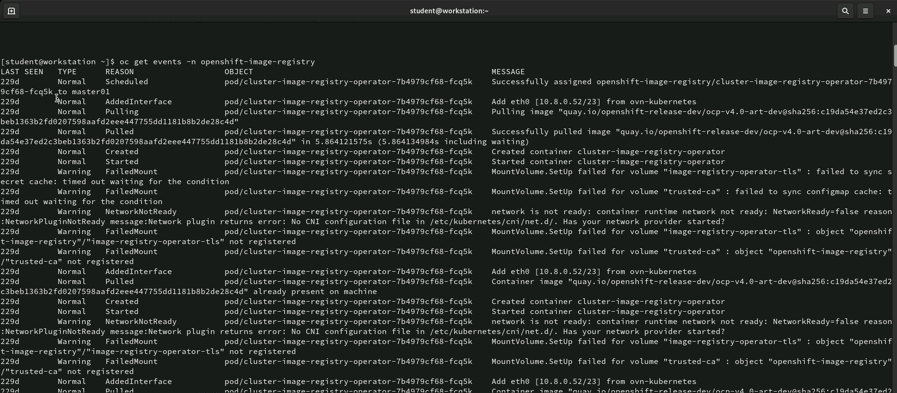
Command: oc get events -n openshift-image-registry
This command retrieves all events related to resources in the openshift-image-registry namespace. The output shows various events like pods being scheduled, interfaces being added, containers being pulled, and potential warnings such as FailedMount and NetworkNotReady issues. Each event includes details such as the event type (e.g., Normal, Warning), reason, the affected object, and a message describing what happened.
This command is useful for tracking actions and issues that occur within the openshift-image-registry namespace, allowing administrators to diagnose and resolve problems by reviewing recent events and warnings.

Slide 36
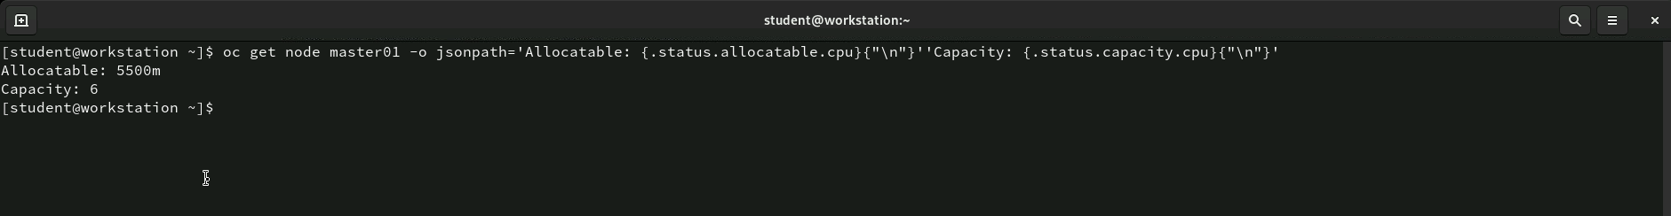
Command: oc get node master01 -o jsonpath='{.status.allocatable.cpu}{"\n"}Capacity: {.status.capacity.cpu}{"\n"}'
The command retrieves the CPU resource details for the node master01, showing the allocatable CPU (available for workloads) as 5500m (5.5 cores) and the total CPU capacity of the node as 6 cores. This is useful for administrators to quickly assess how much CPU is available versus the total capacity on the node, aiding in resource monitoring and planning.

Slide 37
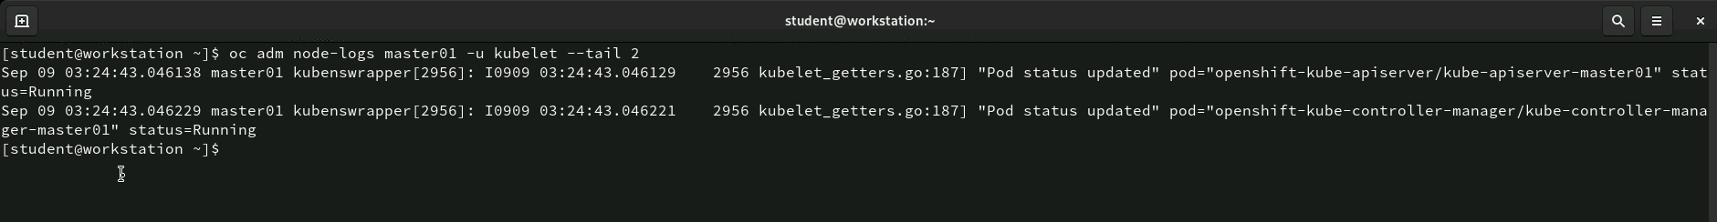
Command: oc adm node-logs master01 -u kubelet --tail 2
This command fetches the kubelet logs from the node master01 and displays the last two log entries (--tail 2). The logs show updates related to the pod status, indicating that the kube-apiserver and kube-controller-manager pods on the master01 node are running.
This command is useful for quickly viewing recent kubelet activity on a node, helping administrators monitor pod status and diagnose potential issues in real-time.

Slide 38
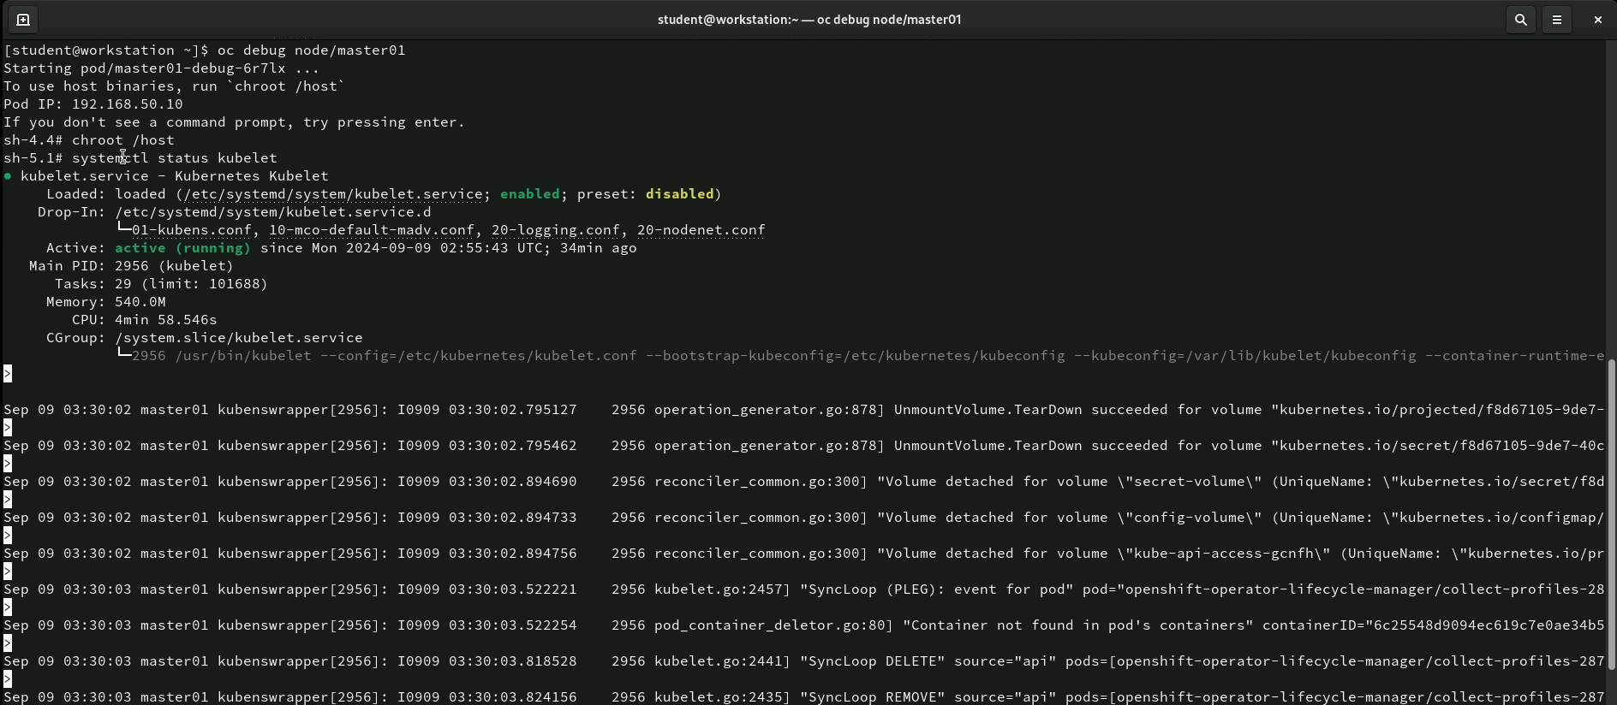
Command: oc debug node/master01
This command initiates a debugging session on the master01 node. It allows administrators to access the node and troubleshoot issues. In this case, the session switches to the node’s root filesystem (chroot /host), where the systemctl status kubelet command is run to check the status of the Kubernetes Kubelet service. The output shows that the kubelet service is active and running, providing details such as its process ID, memory usage, CPU time, and related system logs.
This command is useful for diagnosing issues at the node level, allowing admins to inspect key services like the kubelet, which is critical for managing pods on the node.

Slide 39
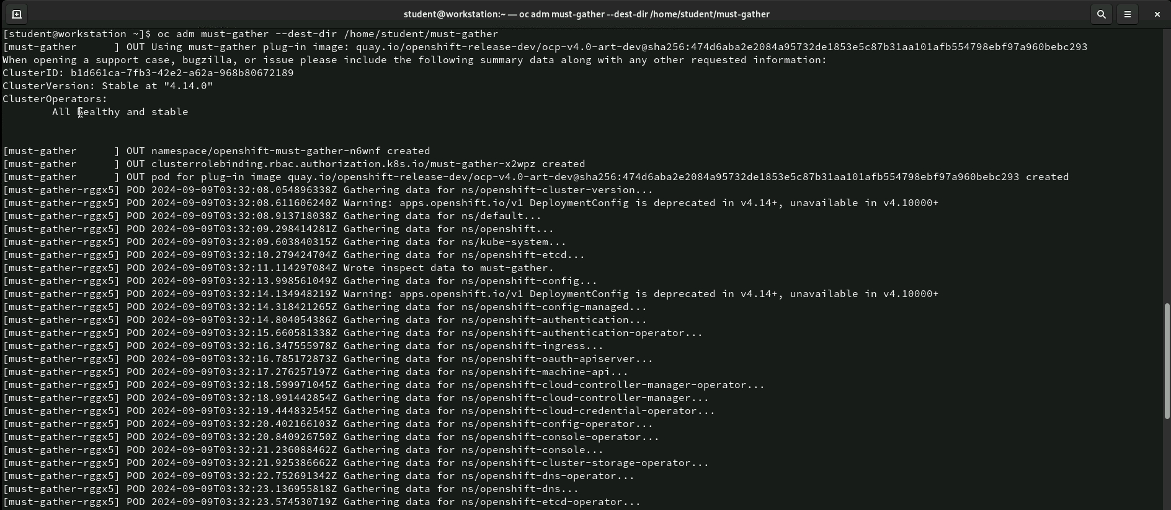
Command: oc adm must-gather --dest-dir /home/student/must-gather
The command oc adm must-gather --dest-dir /home/student/must-gather runs the must-gather tool to collect diagnostic data from the OpenShift cluster, saving it in the specified directory. It gathers information about the cluster version, operator health, and various namespaces, which is useful for troubleshooting and debugging cluster issues. The output confirms that the cluster is healthy and stable before collecting data from multiple components.

Slide 40
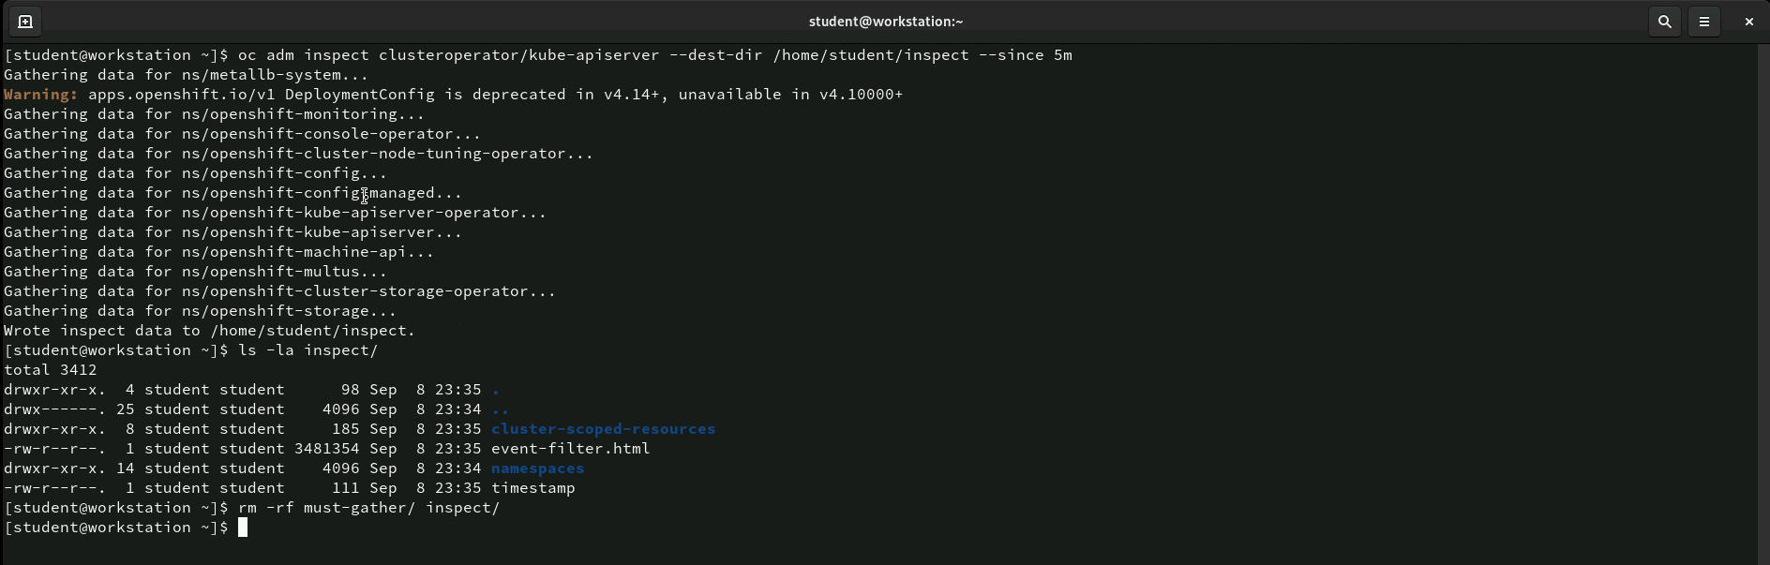
Command: oc adm inspect clusteroperator/kube-apiserver --dest-dir /home/student/inspect --since 5m
The command oc adm inspect clusteroperator/kube-apiserver --dest-dir /home/student/inspect --since 5m collects diagnostic data for the kube-apiserver operator from the last 5 minutes, saving it to the specified directory. It gathers data from relevant namespaces and components for troubleshooting. After gathering, the user lists and then removes the inspection directory. This command helps quickly inspect recent activity related to the kube-apiserver operator.

Slide 41
Thank You!

